Slide 1
Innovation Lessons from 11 Years of Index-Based Livestock Insurance
Christopher B. Barrett
Cornell University
Presentation to USDA Foreign Agricultural Service expert-to-expert dialogue in support of UN Food Systems Summit Action Track 5
Hosted by University of California-Davis
June 28, 2021

Slide 2
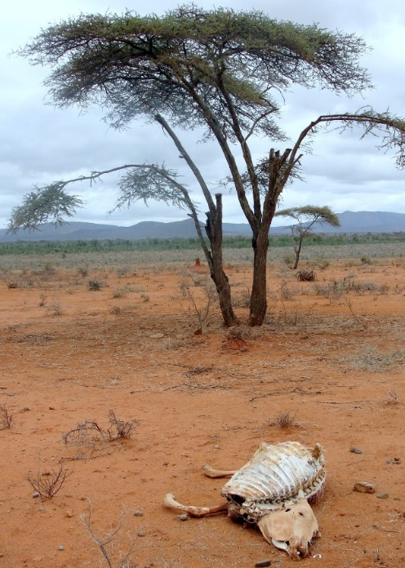
Why IBLI? Poverty Traps And Catastrophic Risk
Poverty traps exist in the arid and semi-arid lands (ASAL) of Kenya/Ethiopia. Catastrophic herd loss risk due to major droughts is the major cause of these dynamics. Puts
a premium on drought risk management, both for
individuals and for society.
Further, doubling drought risk due to climate change
will likely to lead to system collapse in the absence
of any change to prevailing herd dynamics.
Need innovations for pastoralists to avoid/escape traps. Beyond usual responses (food aid, post-drought restocking)
Sources: Lybbert et al. (2004 EJ) and Santos & Barrett (2011 JDE, 2019 UCP/NBER volume) on Boran in s. Ethiopia. Barrett et al. (2006 JDS) and Chantarat et al. (2017 WD) among n. Kenyan pastoralists.
Source: Barrett &Santos (2014 Ecol Econ)

Slide 3
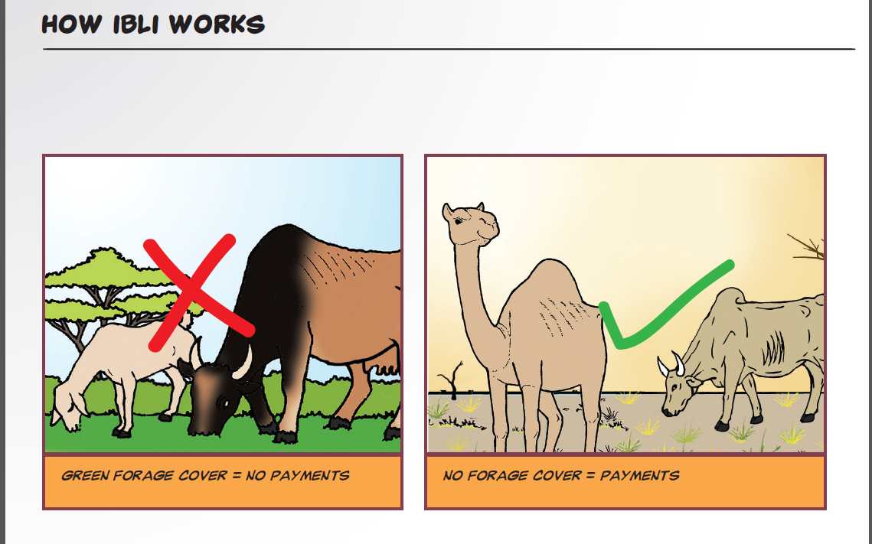
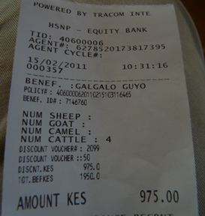
The Index-Based Livestock Insurance Innovation
Partnership among commercial insurers/reinsurers, researchers, local/global NGOs, local/national governments
Insures against unusually low observations of seasonal Normalized Difference Vegetation Index (NDVI) collected by satellite – strongly but imperfectly predictive of herd loss.
Two payout periods in bimodal rainfall zone. Payouts (largely) as designed! ☺
(Chantarat et al. JRI 2013; Jensen et al. Ecol Econ 2019; Johnson et al. JDS 2019)

Slide 4
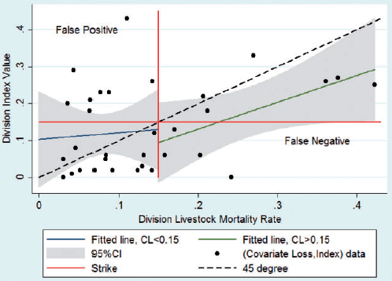
(Jensen, Barrett &2014)
Positive Impacts from an Imperfect Product
Built in careful impact evaluation design to initial roll-out of IBLI in Marsabit, Kenya in Jan 2010 and in Borana, Ethiopia, in Aug 2012.
Good uptake: 47-54% purchased IBLI within 1st 4 sales periods.
A range of factors explain uptake. No real surprises.
Partial coverage: IBLI reduced livestock loss risk exposure 23-38%
Some design risk and some idiosyncratic risk remain.
Big + impacts: Boost milk income/TLU, child MUAC, hh income,
subjective well-being, informal transfers w/n community.
Marginal income/MUAC impact 6-45x that of cash transfers!
Reduced distress livestock sales, herd losses, slaughtering
and meal skipping in response to indemnity payments
Jensen, Barrett & Mude AJAE 2016; Jensen, Mude & Barrett FP 2017; Chantarat et al. WD 2017; Jensen, Barrett & Mude JDE 2017; Toth et al. 2018; ; Janzen & Carter; Tafere, Brrett & Lentz; Takahashi, Barrett & Ikegami - all AJAE 2019; Gebrekidan et al. CRM 2019; Matsuda et al. GPRI 2019; Noritomo & Takahashi in review

Slide 5
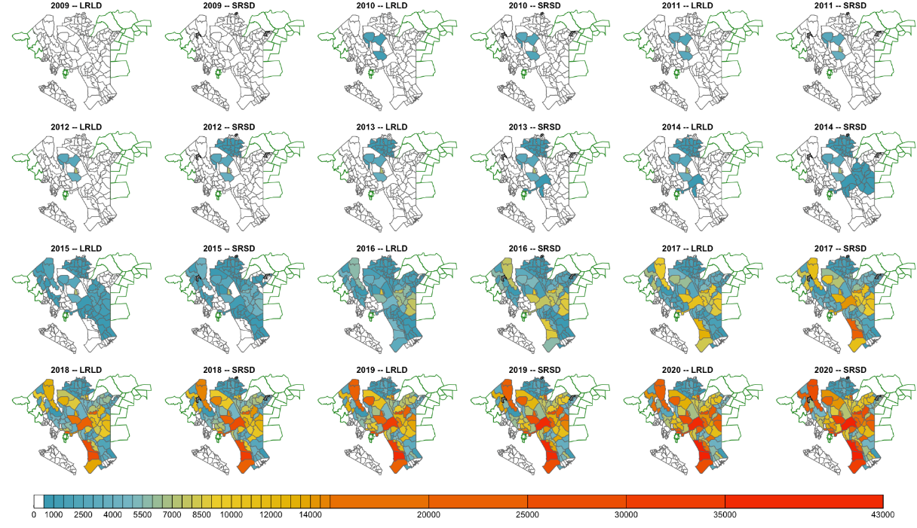
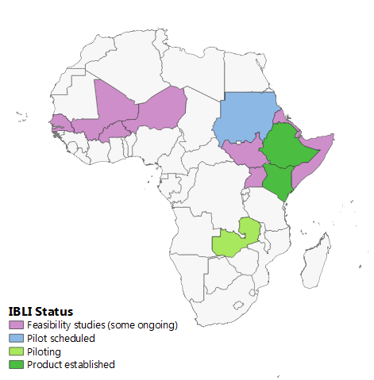
Significant scaling of product
Sharia-compliant version successfully launched (Takaful) 2013
Kenya gov’t took nationwide through Kenya Livestock Insurance Program 2015
WFP using in Somali region Ethiopia,
in Zambia, soon in Sudan, Somalia.
Feasibility studies where:
significant livestock herds
high covariate herd drought loss
OK insurance infrastructure

Slide 6
Key innovation lessons from IBLI
Highly impactful, scaled innovation despite its imperfections and limitations. Keys have been:
Launched from solid empirical and theoretical research
Diverse institutions partnership from the beginning essential
Rigorous M&E crucial to assessment and building support
Engaged operational champions
Bundling – financial innovation requires (i) education, (ii) social protection, (iii) improved RS and operational technologies, (iv) others still TBD (women’s empowerment, conflict resolution, range mgmt., etc.)

Slide 7
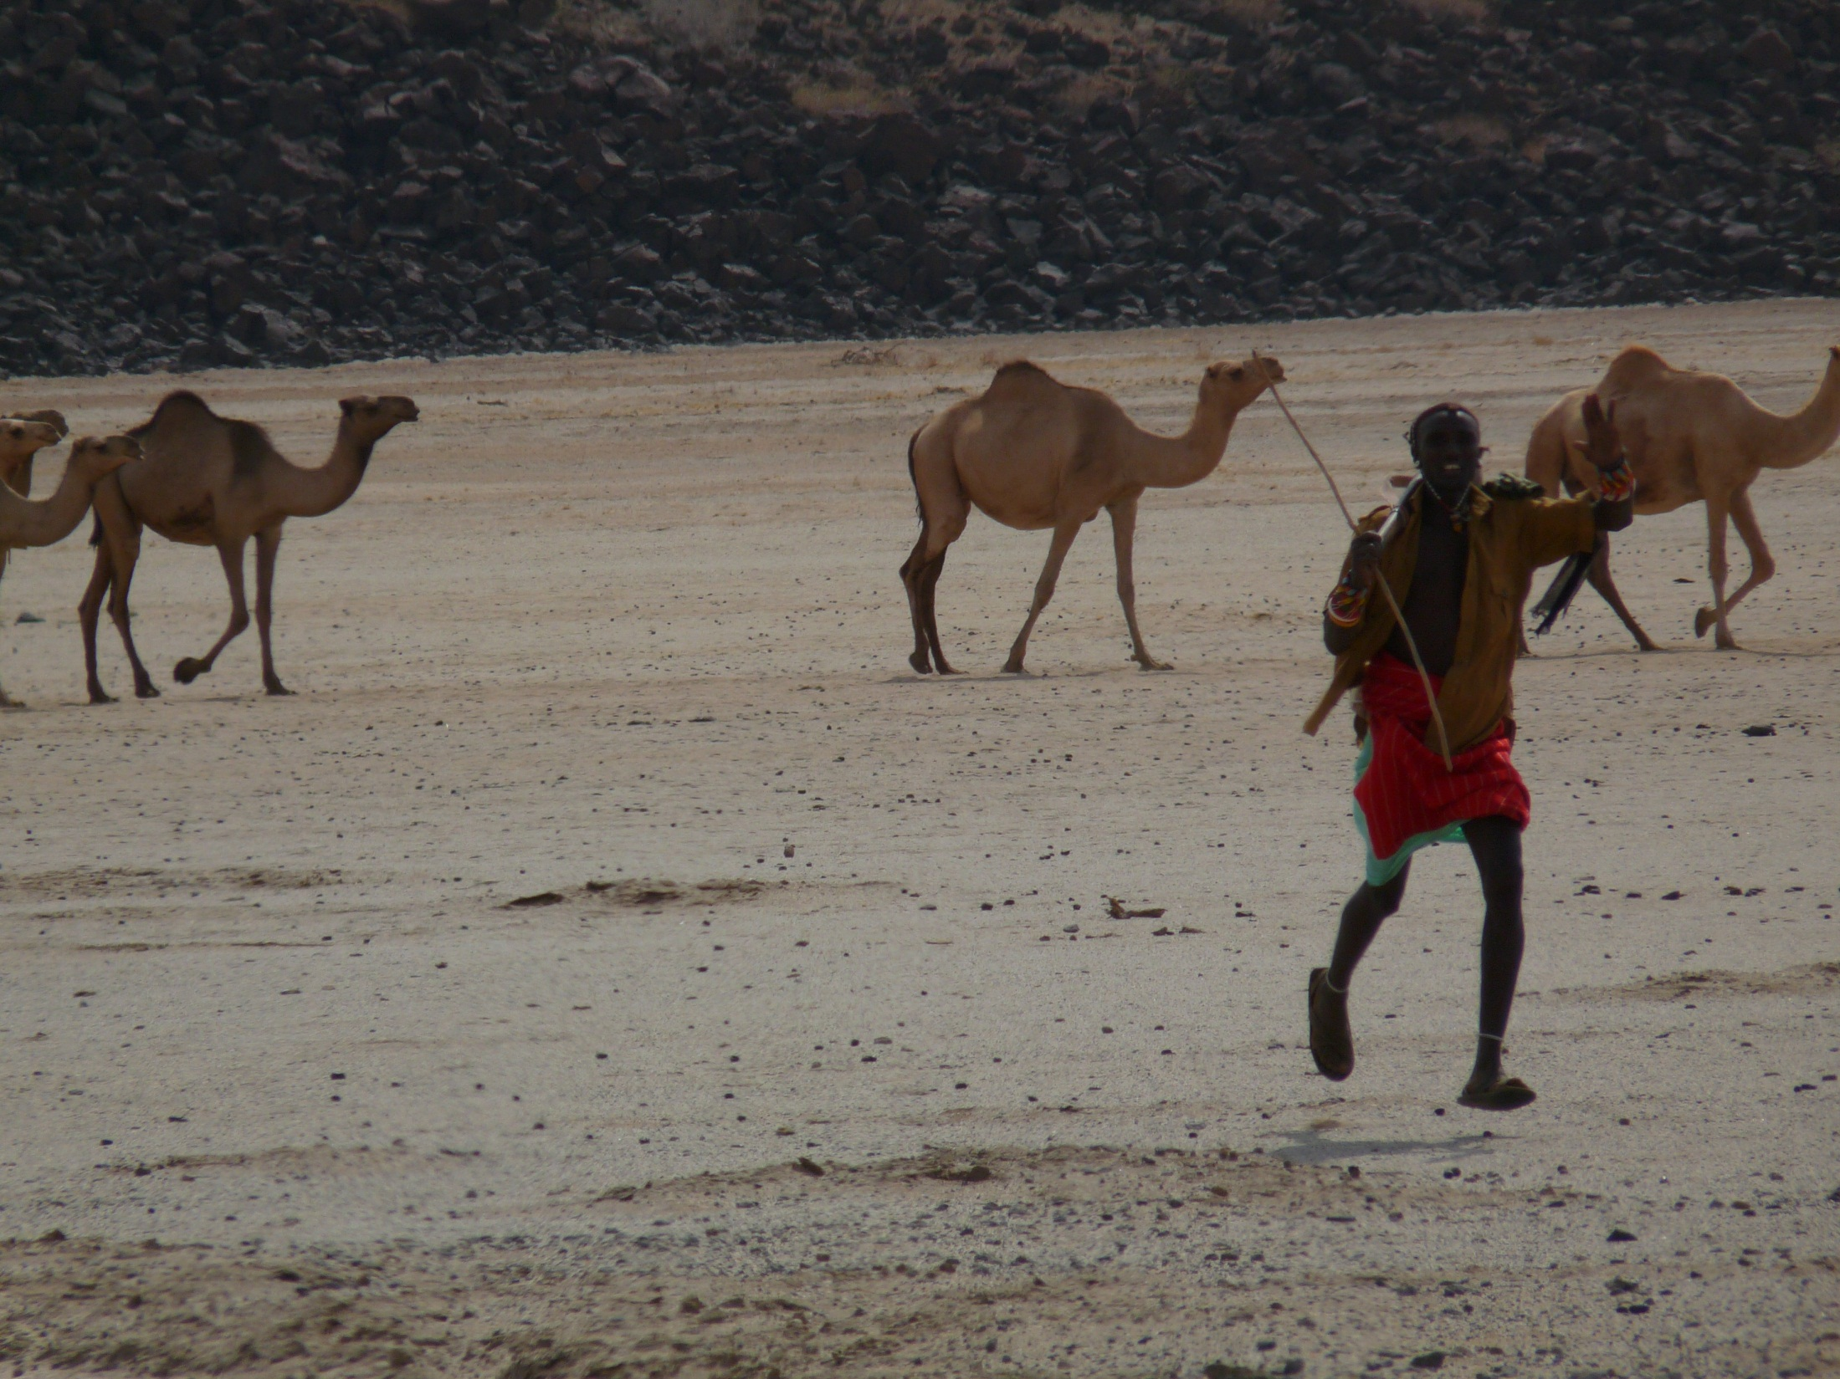
Thank you for your time, interest and comments!
For more information visit https://www.drylandinnovations.com/
Notes:
7

